Slide 1
How Bodies Matter to Minds
Michael L. Anderson
University of Maryland
anderson@cs.umd.edu
http://www.cs.umd.edu/~anderson

Slide 2
Principles of Cognitivism
Cognitivism and GOFAI
Criticisms of Cognitivism
Principles of Embodied AI
The Meaning of Embodiment
Embodiment and Cognition
Broader Implications

Slide 3
I. Principles of Cognitivism
There is a clear distinction between perceptual systems, motor systems, and cognitive systems.
Perception is the passive reception of abstract qualities from the environment, which are recovered by internal representation.

Slide 4
I. Principles of Cognitivism (2)
Cognition is the manipulation of internal representations (symbols) after the fashion of digital computers. Cognition is centralized and general-purpose.
Actions are under the control of the central cognitive systems.

Slide 5
II.Cognitivism and GOFAI
Operate in specially engineered, simplified environments.
Sense this micro-world and try to build two or three dimensional models of it.
Ignore the actual world, and operate on the model to produce a plan of action.
Sense-Model-Plan-Act cycle

Slide 6
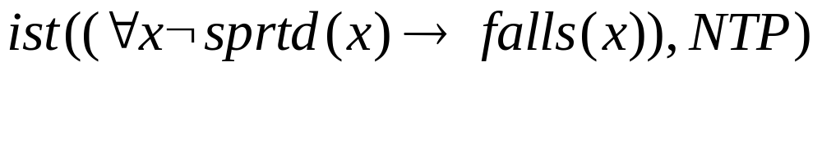
II.Cognitivism and GOFAI (2)
CYC: an example of GOFAI
Knowledge as structured representation

Slide 7
III. Criticisms of Cognitivism
Representation and performance
Context and relevance
Symbol grounding

Slide 8
IV. Principles of Embodied AI
The organism is an agent.
Perception is active and selective.
No clear distinction between perceptual, motor and cognitive systems.
Cognition is characterized by specific, not general solutions.

Slide 9
IV. Principles of Embodied AI (2)
Intelligence is a property of whole organisms in environments.
The organism is evolved.
Cognition is therefore decentralized—the mind is modular—and interactive.

Slide 10
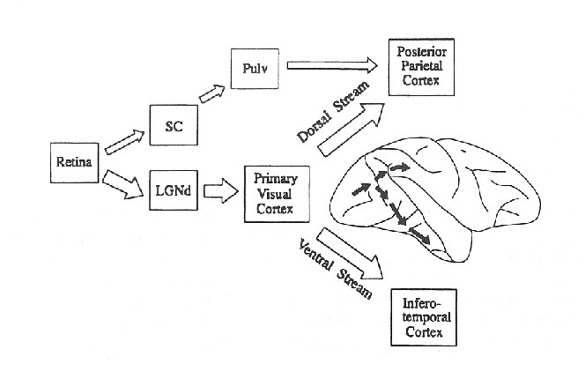
Dorsal and Ventral Streams

Slide 11

Tichener Circles Illusion

Slide 12
V. The Meaning of Embodiment
Agents are:
Physically realized
Environmentally situated
Active
Evolved

Slide 13
VI. Embodiment and Cognition
Color vision
Epistemic actions
Representation and activity

Slide 14
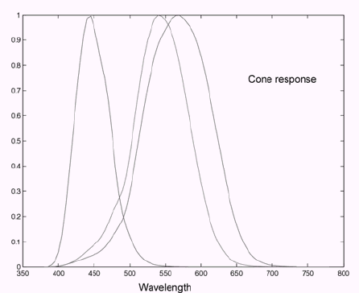

Slide 15
VII. Broader Implications
For perception and representation
For planning
For mind

Slide 16
VII. Implications for perception and representation
Perception is selective and intertwined with action.
Internal representation will be local and action-oriented, rather than objective and action-independent.

Slide 17
VII. Implications for planning
Shorter plans, more frequent attention to the environment, and selective representation.
Interaction as important as symbolic manipulation.
Planning → situated goal orientation/ coping.

Slide 18
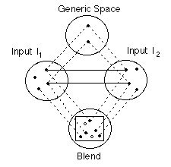
VII. Implications for reason
Reason and metaphor
Conceptual blending

Slide 19
Further Reading
Anderson (2003) Embodied Cognition: A Field Guide. Artificial Intelligence.
Chrisley & Ziemke (2003) Embodiment. Encyclopedia of Cognitive Science.
Ziemke (1999) Rethinking Grounding. Representation in the Cognitive Sciences.

Slide 20
How Bodies Matter to Minds
Michael L. Anderson
University of Maryland
anderson@cs.umd.edu
http://www.cs.umd.edu/~anderson

